Slide 1


Data Science Project
Jarvis AI Assistant
Project Submitted By:-
Name:- Kshitiz Jain
Roll Number:- 1810992009
Mentor:- Dr. Poonam Mam
Instructor:- Dr. Manish Jain

Slide 2
Agenda
INTRODUCTION
OVERVIEW
FEATURES
HOW IT WORKS?
ADVANTAGES-DISADVANTAGES
COMMANDS
CONCLUSION

Slide 3
Introduction
The character has appeared heavily in media adaptations of iron man and avengers stories.
It is commonly reimagined as "just a rather very intelligent system" (J.A.R.V.I.S.).

Slide 4
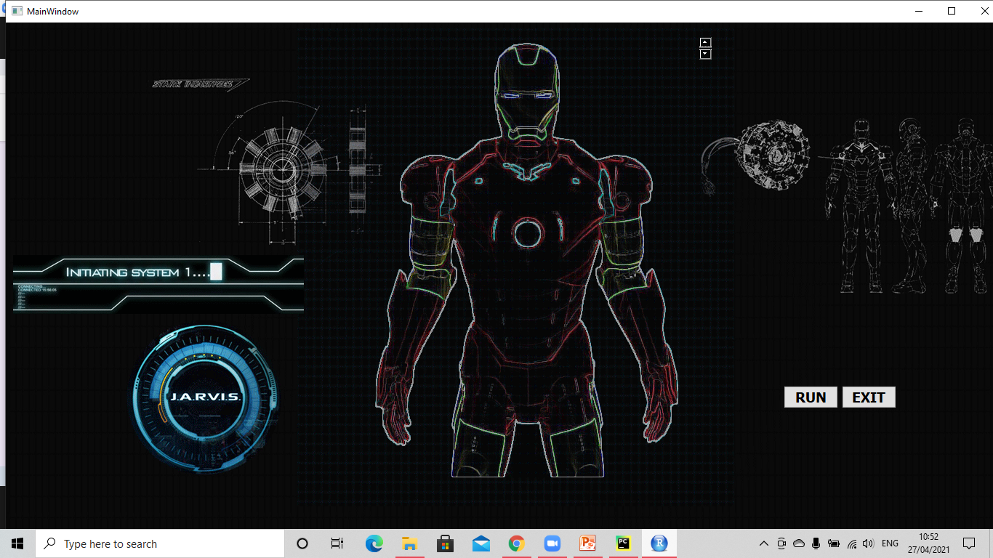
About
Jarvis AI assistant helps you to make your work easier.
Only you have to do is to speak and tell what output do you want to have.
For example:- If we speak ‘where I am’ it will locate you in which city and country you are.

Slide 5
Overview
Jarvis is a digital life assistant.
Based on the DOS language.
It is an open source software.
Jarvis assists with your daily life by acting as an • Alarm clock, • Informing you of the latest news headlines, • The forecast of the weather for the upcoming days.

Slide 6
Features
Answering complex questions
Reading social network messages
Conversing
Energy savings efficiency

Slide 7
Working
Speak something(for e.g. “Hello”)
Jarvis records the voice and match with available commands
If it is available then proper response is provided
And proper action is taken

Slide 8
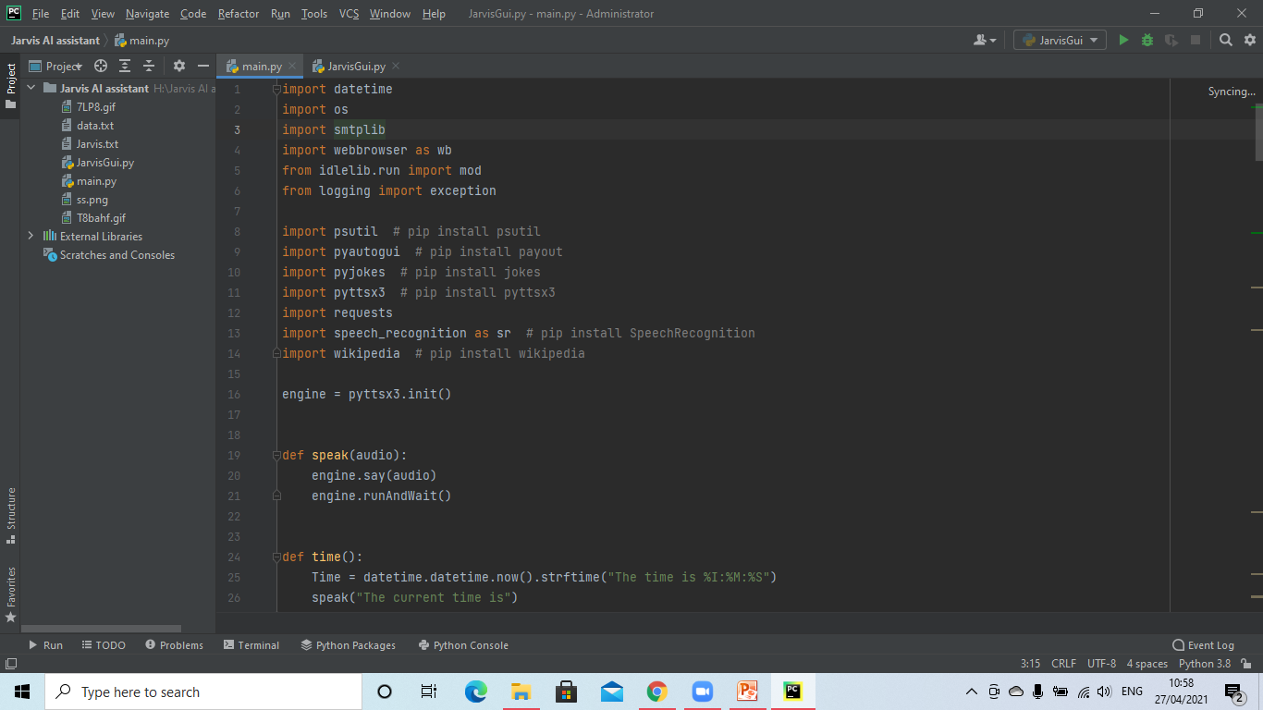
Software Used
Pycharm
Language Used
Python

Slide 9
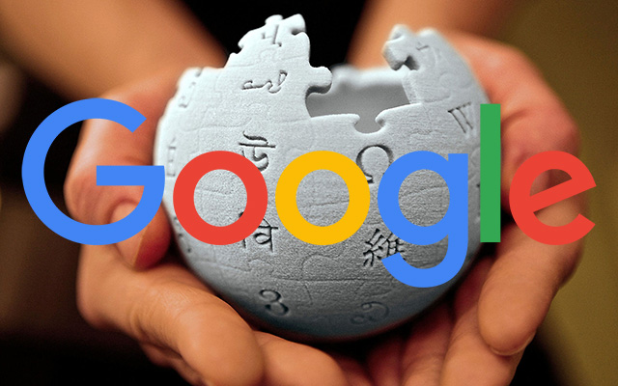
Dataset
In this I have used Google link and wikipedia for the immediate result.
For recognizing voice we have installed library #pip install speech_Recognition

Slide 10
Advantages
Easy to use
Can work with variety of commands
Custom commands
Secure
Helpful for disabled
Artificial intelligent

Slide 11
Disadvantages
Limited language support
Costly
Expensive equipments
It cannot work in noisy environment

Slide 12
Conclusion
Jarvis is a digital and virtual assistant with artificial intelligency.
It is very flexible and useful technology.
It provides a better interface to deal with it.

Slide 13


Slide 14



